Slide 1
Option1

Slide 2

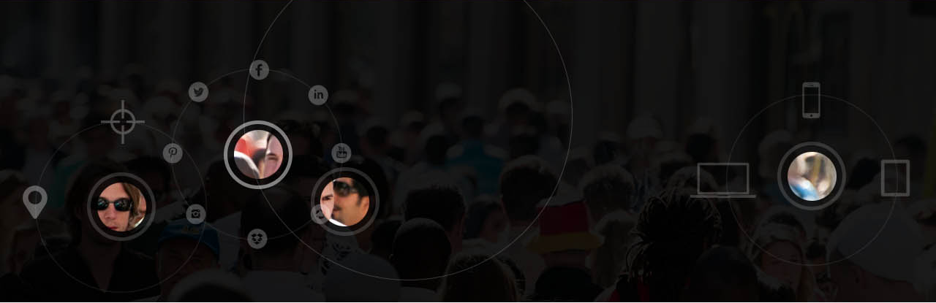




.
.
Sign in
.
This is introduction to the one media. This is introduction to the one media. This is introduction to the one media. This is introduction to the one media.
Option2
Features
This is description. This is description. This is description. This is description. This is description.
This is description. This is description. This is description. This is description. This is description.
This is description. This is description. This is description. This is description. This is description.
Case Study and Testimonials
This is testimonials this is testimonials. This is testimonials this is testimonials. This is testimonials this is testimonials.
This is testimonials this is testimonials. This is testimonials this is testimonials. This is testimonials this is testimonials.
Contact us for a demo
Name
Organisation
Email
Phone Number
Submit
© Copyright OneDigitalAd
Terms of use | About Us | Contact US
Notes:
Pre login home

Slide 3





.
.
Raman
.
New Campaign
0%
Objective
Creative
Target
Location
Budget & Schedule
Review
Objective
Create Afresh Copy from Existing Campaigns
Campaign Name *
Category *
Campaign Type *
Channel *
Essential Information
Web Mobile
*
Cancel
Next
© Copyright OneDigitalAd
Terms of use | About Us | Contact US
Notes:
When mobile is selected, variants (iPhone, windows, Android) can be specified

Slide 4
Option2

Slide 5

.
.
OneMedia
Sign in
.
This is introduction to the one media. This is introduction to the one media. This is introduction to the one media. This is introduction to the one media.
Features
This is description. This is description. This is description. This is description. This is description.
This is description. This is description. This is description. This is description. This is description.
This is description. This is description. This is description. This is description. This is description.
Case Study and Testimonials
This is testimonials this is testimonials. This is testimonials this is testimonials. This is testimonials this is testimonials.
This is testimonials this is testimonials. This is testimonials this is testimonials. This is testimonials this is testimonials.
Contact us for a demo
Name
Organisation
Email
Phone Number
Submit
© Copyright OneDigitalAd
Terms of use | About Us | Contact US
Notes:
Pre login home

Slide 6
.
.
.
.
.
OneMedia
Raman
.
Raman
0%
New Campaign
0%
New Campaign
Objective
Creative
Target
Location
Budget & Schedule
Review
Objective
Create Afresh Copy from Existing Campaigns
Campaign Name *
Category *
Campaign Type *
Channel *
Essential Information
Web Mobile
*
Cancel
Next
© Copyright OneDigitalAd
Terms of use | About Us | Contact US
Notes:
When mobile is selected, variants (iPhone, windows, Android) can be specified

Slide 7
Option3

Slide 8
.
.
OneMedia
Sign in
.
This is introduction to the one media. This is introduction to the one media. This is introduction to the one media. This is introduction to the one media.
Features
This is description. This is description. This is description. This is description. This is description.
This is description. This is description. This is description. This is description. This is description.
This is description. This is description. This is description. This is description. This is description.
Case Study and Testimonials
This is testimonials this is testimonials. This is testimonials this is testimonials. This is testimonials this is testimonials.
This is testimonials this is testimonials. This is testimonials this is testimonials. This is testimonials this is testimonials.
Contact us for a demo
Name
Organisation
Email
Phone Number
Submit
© Copyright OneDigitalAd
Terms of use | About Us | Contact US
Notes:
Pre login home

Slide 9
.
.
Raman
.
New Campaign
0%
Objective
Creative
Target
Location
Budget & Schedule
Review
Objective
Create Afresh Copy from Existing Campaigns
Campaign Name *
Category *
Campaign Type *
Channel *
Essential Information
Web Mobile
*
Cancel
Next
© Copyright OneDigitalAd
Terms of use | About Us | Contact US
Notes:
When mobile is selected, variants (iPhone, windows, Android) can be specified

Slide 10
Option4

Slide 11
.
.
OneMedia
Sign in
.
This is introduction to the one media. This is introduction to the one media. This is introduction to the one media. This is introduction to the one media.
Features
This is description. This is description. This is description. This is description. This is description.
This is description. This is description. This is description. This is description. This is description.
This is description. This is description. This is description. This is description. This is description.
Case Study and Testimonials
This is testimonials this is testimonials. This is testimonials this is testimonials. This is testimonials this is testimonials.
This is testimonials this is testimonials. This is testimonials this is testimonials. This is testimonials this is testimonials.
Contact us for a demo
Name
Organisation
Email
Phone Number
Submit
© Copyright OneDigitalAd
Terms of use | About Us | Contact US
Notes:
Pre login home

Slide 12
.
.
OneMedia
Raman
.
New Campaign
0%
Objective
Creative
Target
Location
Budget & Schedule
Review
Objective
Create Afresh Copy from Existing Campaigns
Campaign Name *
Category *
Campaign Type *
Channel *
Essential Information
Web Mobile
*
Cancel
Next
© Copyright OneDigitalAd
Terms of use | About Us | Contact US
Notes:
When mobile is selected, variants (iPhone, windows, Android) can be specified

Slide 13
Option5

Slide 14
.
.
OneMedia
Raman
.
This is introduction to the one media. This is introduction to the one media. This is introduction to the one media. This is introduction to the one media.
Features
This is description. This is description. This is description. This is description. This is description.
This is description. This is description. This is description. This is description. This is description.
This is description. This is description. This is description. This is description. This is description.
Case Study and Testimonials
This is testimonials this is testimonials. This is testimonials this is testimonials. This is testimonials this is testimonials.
This is testimonials this is testimonials. This is testimonials this is testimonials. This is testimonials this is testimonials.
Contact us for a demo
Name
Organisation
Email
Phone Number
Submit
© Copyright OneDigitalAd
Terms of use | About Us | Contact US
Notes:
Pre login home

Slide 15
.
.
OneMedia
.
OneMedia
Raman
New Campaign
0%
Objective
Creative
Target
Location
Budget & Schedule
Review
Objective
Create Afresh Copy from Existing Campaigns
Campaign Name *
Category *
Campaign Type *
Channel *
Essential Information
Web Mobile
*
Cancel
Next
© Copyright OneDigitalAd
Terms of use | About Us | Contact US
Notes:
When mobile is selected, variants (iPhone, windows, Android) can be specified

Slide 16
Option1a

Slide 17
.
.
Sign in
.
This is introduction to the one media. This is introduction to the one media. This is introduction to the one media. This is introduction to the one media.
Option2
Features
This is description. This is description. This is description. This is description. This is description.
This is description. This is description. This is description. This is description. This is description.
This is description. This is description. This is description. This is description. This is description.
Case Study and Testimonials
This is testimonials this is testimonials. This is testimonials this is testimonials. This is testimonials this is testimonials.
This is testimonials this is testimonials. This is testimonials this is testimonials. This is testimonials this is testimonials.
Contact us for a demo
Name
Organisation
Email
Phone Number
Submit
© Copyright OneDigitalAd
Terms of use | About Us | Contact US
Notes:
Pre login home

Slide 18
.
.
Raman
.
New Campaign
0%
Objective
Creative
Target
Location
Budget & Schedule
Review
Objective
Create Afresh Copy from Existing Campaigns
Campaign Name *
Category *
Campaign Type *
Channel *
Essential Information
Web Mobile
*
Cancel
Next
© Copyright OneDigitalAd
Terms of use | About Us | Contact US
Notes:
When mobile is selected, variants (iPhone, windows, Android) can be specified

